Slide 1
Azure App Service Connectivity
How to connect to Vnets
Using VNET integration
requires a Standard, Premium, or Isolated pricing plan
works with Web, Mobile, API apps, and Function apps
enables an app to connect to only 1 VNet at a time
enables up to five VNets to be integrated with in an App Service Plan
allows the same VNet to be used by multiple apps in an App Service Plan
supports a 99.9% SLA due to the SLA on the VNet Gateway
Directly deployed into VNET as App Service Environment (ASE)
An ASE can be either internet-facing with a public IP address or internal-facing with only an Azure internal load balancer (ILB) address.
Network Security Groups restrict inbound network communications to the subnet where an ASE resides. You can use NSGs to run apps behind upstream devices and services such as WAFs and network SaaS providers.

Slide 2
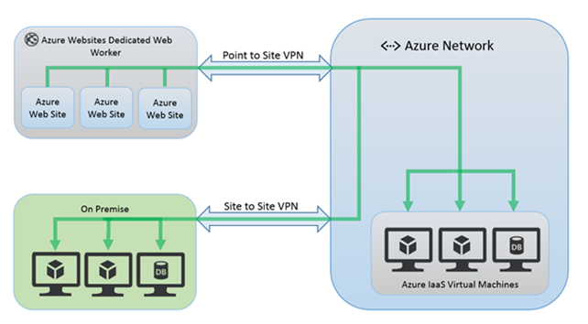
Azure App Service Connectivity
How to connect to in-prem database
In-Prem database is accessible via VNETs connection to in-prem

